Slide 1
Database Systems
Lecture 12
TYPES OF RELATIONSHIPS

Slide 2
Types of Relationship
Unary relationship
Binary relationship
Ternary relationship
N-ary relationship

Slide 3
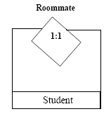
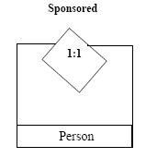
Unary relationship
An ENTITY TYPE linked with itself, also called recursive relationship.
Example Roommate, where STUDENT is linked with STUDENT

Slide 4

Binary relationship
A Binary relationship is the one that links two entities sets e.g. STUDENT-CLASS.
Relationships can be formally described in an ordered pair form. Enroll = {(S1001, ART103A), (S1020, CS201A), (S1002, CSC201A)}
Entire set is relationship set and each ordered pair is an instance of the relationship.

Slide 5
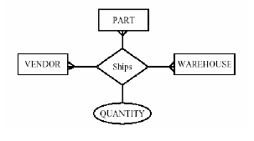
Ternary relationship
A Ternary relationship is the one that involves three entities e.g.,
STUDENT-CLASS-FACULTY OR
VENDOR-PART-WAREHOUSE

Slide 6
N-ary relationship
Most relationships in data model are binary or at most ternary but we could define a relationship set linking any number of entity sets i.e. n-ary relationship

Slide 7
Relationship Cardinalities
The cardinality of a relationship is the number of entities to which another entity can map under that relationship.
One-to-One mapping
Many-to-One mapping
One-to-Many mapping
Many-to-Many mapping

Slide 8

One-to-One Mapping
A mapping R from X to Y is one-to-one if each entity in X is associated with at most one entity in Y and vice versa.

Slide 9
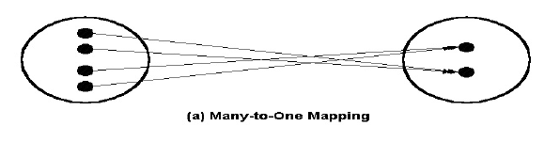
Many-to-One Mapping
A mapping R from X to Y is many-to-one if each entity in X is associated with at most one entity in Y but each entity in Y is associated with many entities in X.

Slide 10
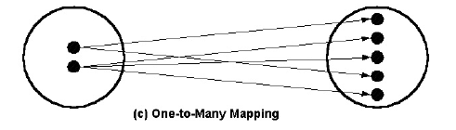
One-to-Many Mapping
A mapping R from X to Y is one-to-many if each entity in X is associated with many entities in Y but each entity in Y is associated with one entity in X.

Slide 11
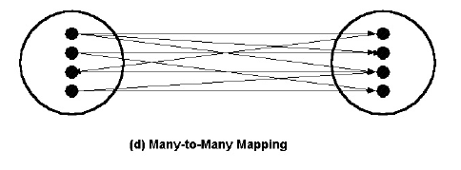
Many-to-Many Mapping
A mapping R from X to Y is many-to-many if each entity from X is associated with many entities in Y and one entity in Y is associated with many entities in X.

Slide 12
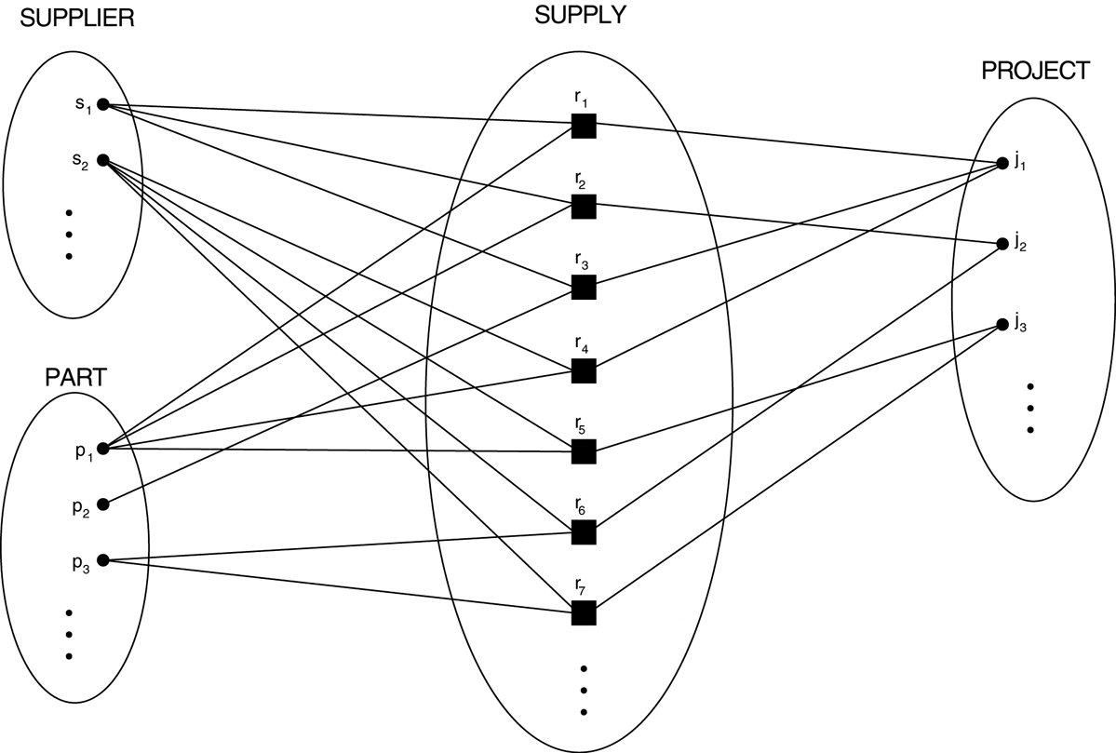
Choosing between Binary and Ternary (or Higher-Degree) Relationships

Slide 13
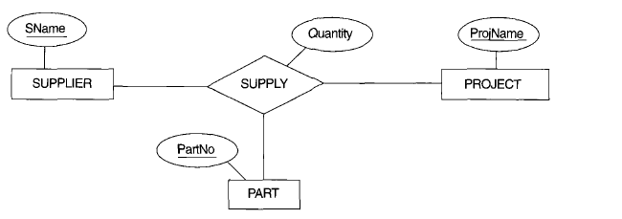
Choosing between Binary and Ternary (or Higher-Degree) Relationships
Relationship set of SUPPLY is a set of relationship instances (s, j, p), where s is a SUPPLIER who is currently supplying a PART p to a PROJECT j. In general, a relationship type R of degree n will have n edges in an ER diagram, one connecting R to each participating entity type.

Slide 14
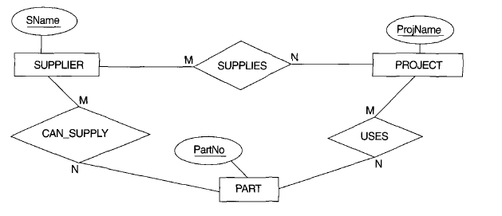
Choosing between Binary and Ternary (or Higher-Degree) Relationships

Slide 15
Choosing between Binary and Ternary (or Higher-Degree) Relationships
Three binary relationship types CAN_SUPPLY, USES, and SUPPLIES. Suppose that
CAN_SUPPLY, between SUPPLIER and PART, includes an instance (s, p) whenever supplier s can supply part p (to any project);
USES, between PROJECT and PART, includes an instance (j, p) whenever project j uses part p;
SUPPLIES, between SUPPLIER and PROJECT, includes an instance (s, j) whenever supplier s supplies some part to project j

Slide 16
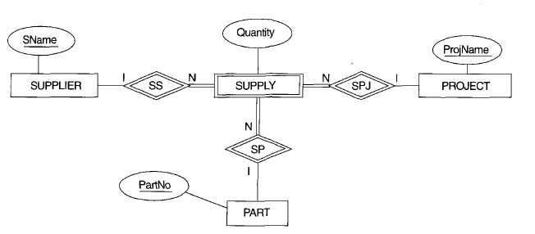
Choosing between Binary and Ternary (or Higher-Degree) Relationships
Some database design tools are based on variations of the ER model that permit only binary relationships. In this case, a ternary relationship such as SUPPLY must be represented as a weak entity type, with no partial key and with three identifying relationships.

Slide 17
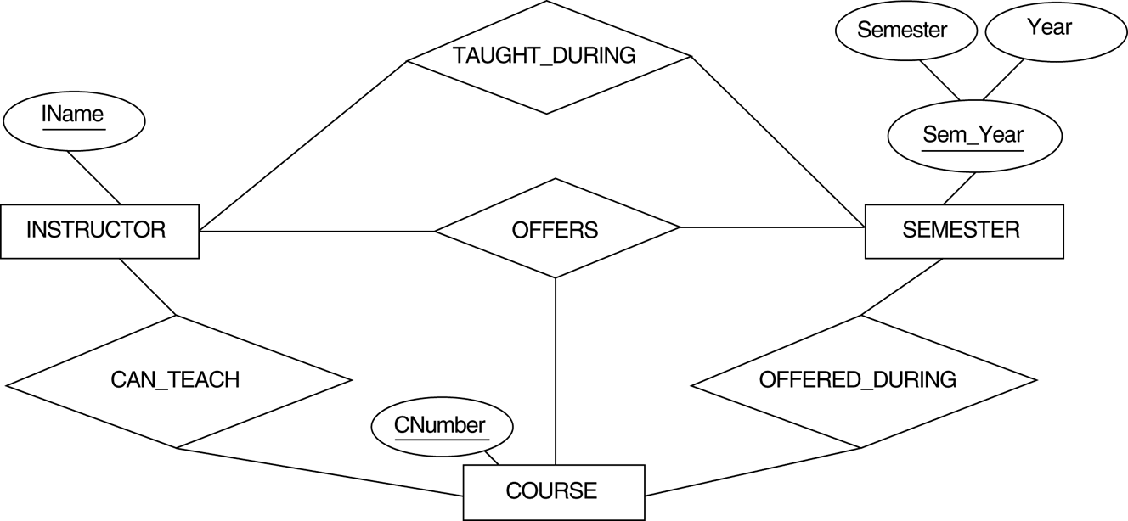
Another example of ternary versus binary relationship types.

Slide 18
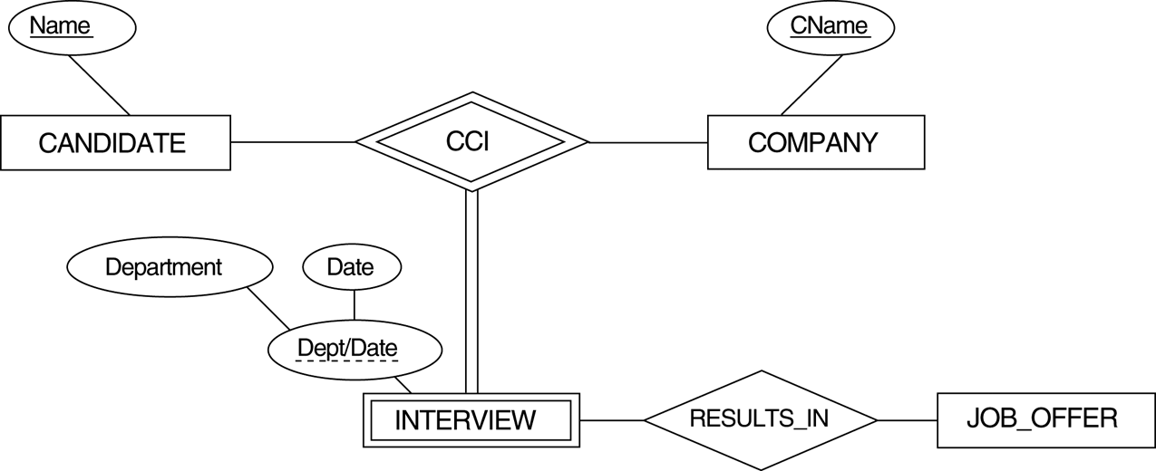
A weak entity type INTERVIEW with a ternary identifying relationship type.

